Slide 1
系統設計書—醫雲復健醫療
medcloud-rehabil-view
Product Owner | 孫培然
Scrum Master | 卓曉霜
Scrum Team | 魏瑋序、許家綺
2020.03.12 編制

Slide 2
系統設計大綱
UI & Event Binding
ViewModel
View Service
WebAPI Controller
Model Service
Stored Procedure

Slide 3
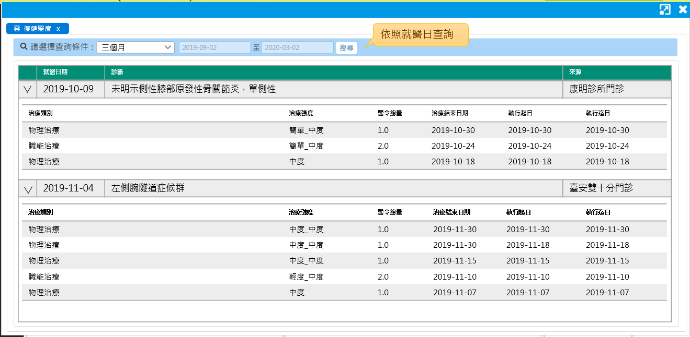
1. UI & Event Binding
序 | 事件名稱
1 | onRangeChange($event)
2 | onSearchClick($event)
❶
❷

Slide 4
2. ViewModel
DateRange
Name |  | DataType
+ name | : | string
+ value | : | number
Rehabil
Name |  | DataType
+ visitDate | : | Date
+ diagName | : | string
+ hospitalName | : | string
+ rehabilDetails | : | RehabilDetail[]
Column
Name |  | DataType
+ header | : | string
+ field | : | string
SearchReq
Name |  | DataType
+ idNo | : | string
+ startDate | : | Date
+ endDate | : | Date
SearchLog
Name |  | DataType
+ Type | : | number
+ systemTime | : | datetime
+ systemUser | : | number
RehabilDetail
Name |  | DataType
+ rehTypeName | : | string
+ rehLevel | : | string
+ orderQty | : | number
+ rehEndDate | : | Date
+ execStartDate | : | Date
+ execEndDate | : | Date

Slide 5
3. View Service
Page | Description | Property / Event | View Service | Input | Output
復健治療畫面 | 頁面初始預設 | ngOnInit() | getRehabilList() | SearchReq | Rehabil[]
 | 依照日期範圍搜尋列表 | onSearchClick($event) | getRehabilList() | SearchReq | Rehabil[]
 | 儲存查詢紀錄 | (尚待規劃) |  | SearchLog | Boolean

Slide 6
4. WebAPI Controller
Description | Method | URL (/webApi/medcloud/) | Input | Output
取得醫雲復健列表 | POST | getRehabilList | SearchReq | Rehabil[]
儲存查詢紀錄 | POST | setECCSearchLog (尚待規劃) | ECSearchLog | Boolean

Slide 7
5. Model Service
Description | Service Function | Input | Output
取得醫雲復健列表 | getRehabilList() | SearchReq | Rehabil[]
儲存查詢紀錄 | (尚待規劃) | SearchLog | Boolean

Slide 8
6. Stored Procedure
<註> 副主任指示現階段直接用NodeJs寫Sql抓informix，所以無stored procedure (2020-03-12)

